Slide 1
Data Analytics

Slide 2
CART vs Logistic Regression
Linear relationships
Interactions
General Comments

Slide 3
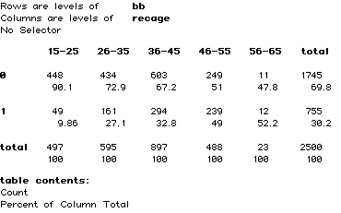
Linear relationships and Trees

Slide 5
Logistic regression
Coefficients:
 | Estimate | Std.Error | z | Pr(>|z|)
(Intercept) | -3.109804 | 0.186154 | -16.71 | <2e-16
age | 0.060985 | 0.004687 | 13.01 | <2e-16

Slide 6
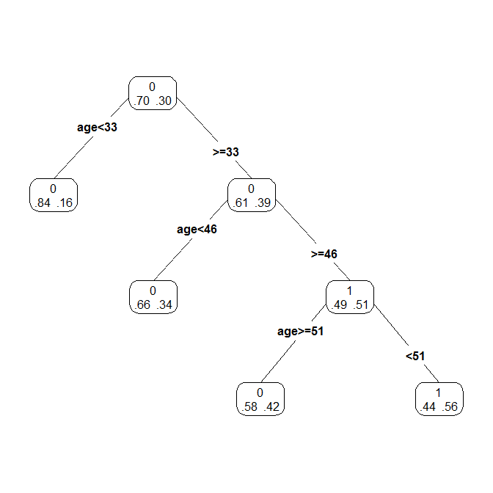

Slide 7
Interaction between two variables
Outcome variable Y (1/0)
Input variables X1 and X2
What do we mean by interaction here?
How do we model this in logistic regression?
What happens with trees?
Look at simple representation of data

Slide 8
Trees and Interactions – Case 1 Proportion of 1’s in a cell

Slide 9
Coefficients:
 | Estimate | Std. | Error | z
(Intercept) | -4.5094 | 0.23937 | -18.84 | <2e-16
x1 | 2.27083 | 0.11185 | 20.3 | <2e-16
x2 | 2.19386 | 0.11073 | 19.81 | <2e-16
x1:x2 | -1.10495 | 0.05174 | -21.35 | <2e-16

Slide 10
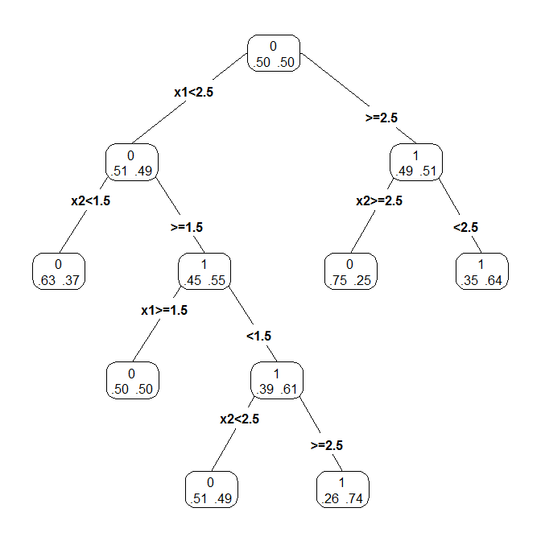

Slide 11
Case 2

Slide 12
Case 2
Coefficients:
 | Estimate | Std. Error | z | Pr(>|z|)
(Intercept) | -0.07468 | 0.10752 | -0.695 | 0.487
x1 | 0.05068 | 0.03653 | 1.387 | 0.165
x2 | -0.01334 | 0.03652 | -0.365 | 0.715

Slide 13
Case 3

Slide 14
Results of logistic regression
Coefficients:
 | Estimate | Std. | Error | z
(Intercept) | 1.29244 | 0.06471 | 19.973 | <2e-16
X1 | -0.6421 | 0.02218 | -28.952 | <2e-16
x2 | -0.0095 | 0.02179 | -0.436 | 0.663

Slide 15
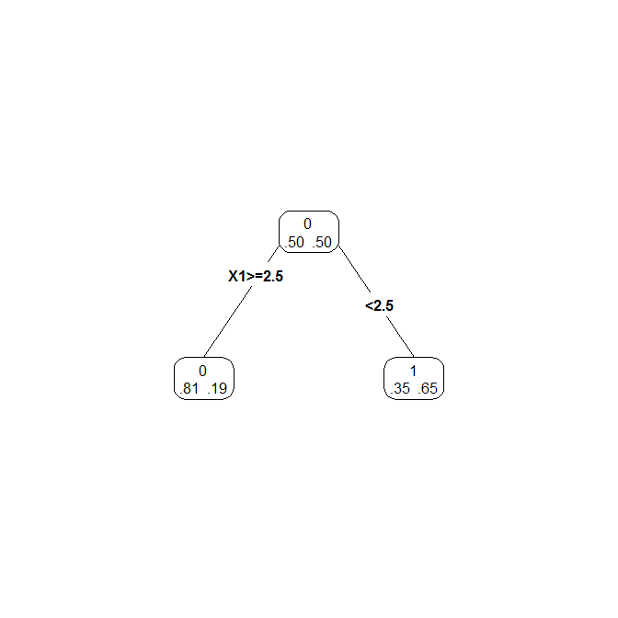

Slide 16
How CART works
CART excels in the detection of local structure
Each half of the tree is analysed separately
Discovery of patterns becomes progressively more local
Information from different nodes is not pooled or combined
The fit at one node is never adjusted to take into account the fit at another node

Slide 17
Core CART features
Automatic separation of relevant from irrelevant predictors
Does not require transform such as log, square root etc.
Automatic interaction detection
Impervious to outliers
Methods for dealing with missing values
Requires only moderate supervision by analyst
First time model is often as good as a neural net by an expert

Slide 18
Logistic regression
Logistic regression excellent performer
Provides a smooth continuous predicted probability of class membership
a small change in predictor variable yields a small change in predicted probability
Effective capture of global features of data
Main effects model reflect show probability responds to predictor x over entire range of x
Some flexibility allowed with transformation, polynomials and interactions
Provides standard errors of the coefficients

Slide 19
Excel at different tasks
CART - very bad at detecting linear structure. Recognizes it but cannot represent it effectively.
With many variables, linear structure will not be obvious from CART output
Can produce a very large tree in an attempt to represent very simple relationships
Logistic regression- good for linear relationships
Many non-linear structures can still be reasonably approximated with a linear structure
Even incorrectly specified logistic regression can perform well

Slide 20
How do we combine logistic regerssion and CART?
No information left in terminal nodes to support further analysis
In a well developed CART tree no other model should be supportable in the nodes
Run a shallow tree
Assign every case to terminal node
Terminal node assignment reported by categorical variable with as many levels as terminal nodes
Feed this categorical variable in the form of terminal node dummies to a logit model

Slide 21
CART and Hybrid models
CART only with j terminal nodes
CART-Logistic regression Hybrid model

